Slide 1
How to make an auto flight?: plane
Skywalker 1900 airframe
Dr. Tadej Kosel
AFSL
June 27th 2017

Slide 2
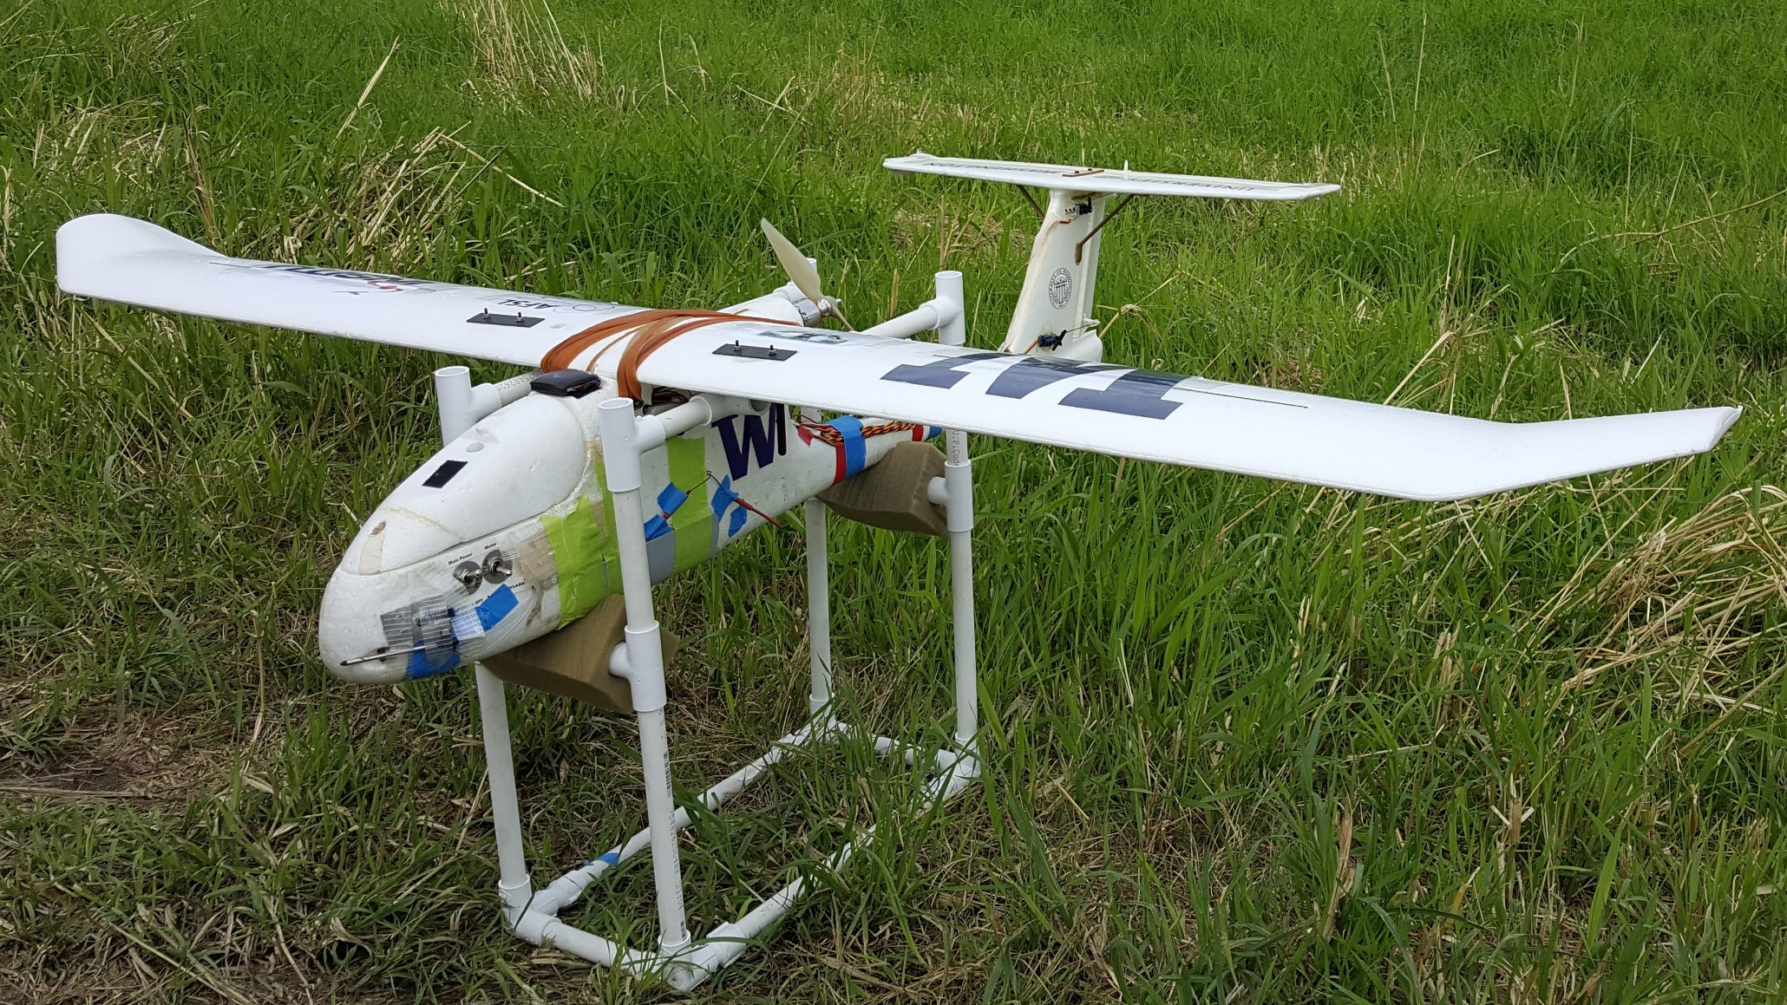
Skywalker 1900 airframe

Slide 3
Important auto flight parameters for HAND LAUNCHING:
AUTO TAKE-OFF
- TKOFF_THR_MINACC
parameter controls the minimum forward acceleration of the aircraft before the throttle will engage (set value = 0 m/s²)
- TKOFF_THR_DELAY
parameter is a delay in 1/10 of a second units to hold off starting the motor after the minimum acceleration is reached (set value = 0 s)
- TKOFF_THR_MINSPD
parameter is a minimum ground speed (as measured by the GPS) before the motor starts
(set value = 0 m/s)
- TECS_PITCH_MAX
controls the maximum pitch which the autopilot will demand in auto flight (set value = 0) -> take effect LIM_PITCH_MAX
- LIM_PITCH_MAX
Maximum pitch angle in FBWA and auto flight (set value = 25 deg)
More info: http://ardupilot.org/plane/docs/automatic-takeoff.html

Slide 4
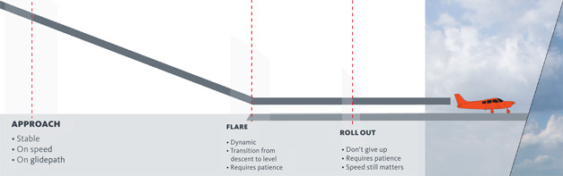
AUTO LANDING: APPROACH AND FLARE
The final stage of the landing is called the “flare”. During the flare the aircraft tries to retain a course along the line between the last waypoint and the landing waypoint, and it controls it’s height solely using a target descent rate. Once the flare is started the throttle is “disabled” - set to some value between THR_MIN and zero.
More info: http://ardupilot.org/plane/docs/automatic-landing.html

Slide 5
AUTO LANDING
- LAND_FLARE_SEC
This is the time in seconds before the aircraft would hit the ground if it continued with its current descent rate. (set value = 0 s) - LAND_FLARE_ALT
That is an altitude above the ground in meters at which the aircraft will flare, regardless of its descent rate (set value = 3 m)
More info: http://ardupilot.org/plane/docs/automatic-landing.html

Slide 6
- TECS_LAND_SINK
The sink rate for the final stage of landing (set value = 0.25 m/s)
- LAND_PITCH_CD
Sets the minimum pitch target in the flare (in centi-degrees) (set value = 1500 cdeg)
- TECS_LAND_DAMP
Damping constant for the pitch control during flare. A larger number will cause the pitch demand to change more slowly (in centi-degrees) (set value = 0.5 cdeg)
- LEVEL_ROLL_LIMIT
Prevent wing strike, so if there is a significant cross-wind then it is likely that the aircraft will not be able to maintain the exact path (set value = 5 deg)
AFTER LANDING
- LAND_DISARMDELAY
Will disarm the motor after landing (set value = 5 s)
- LAND_THEN_NEUTRL
Set servos to neutral after landing (set value = 1)

Slide 7

ALWAYS TAKE-OFF AND LAND INTO THE WIND!!!

Slide 8
Planning of auto flight take-off and landing pattern
TAKE-OFF
MISSION
LANDING

Slide 9
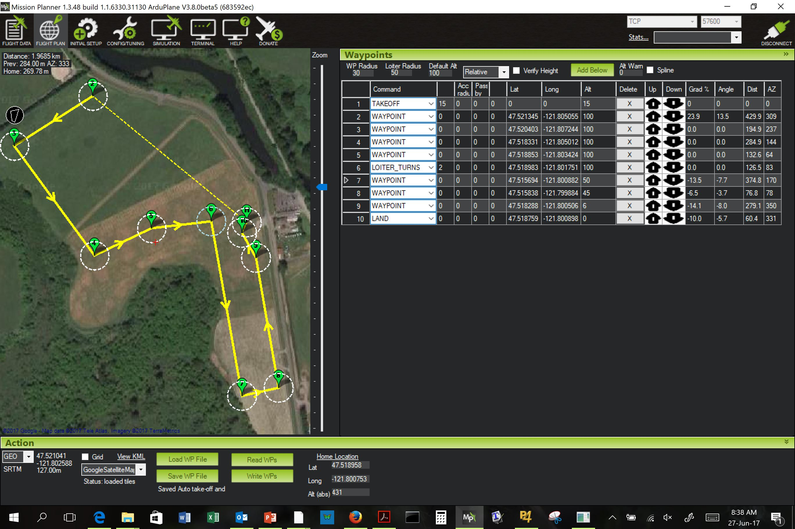

Slide 10
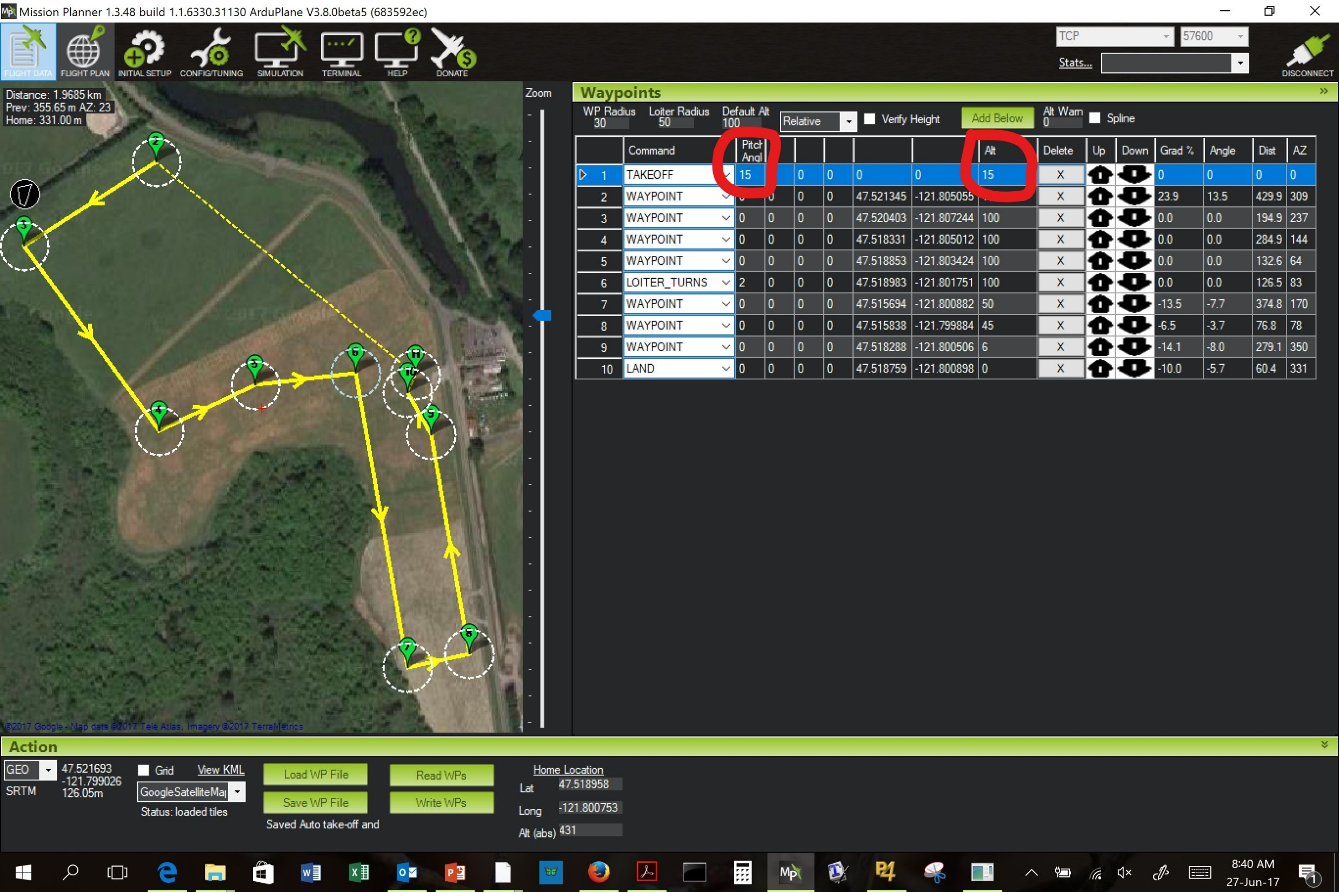

Slide 11
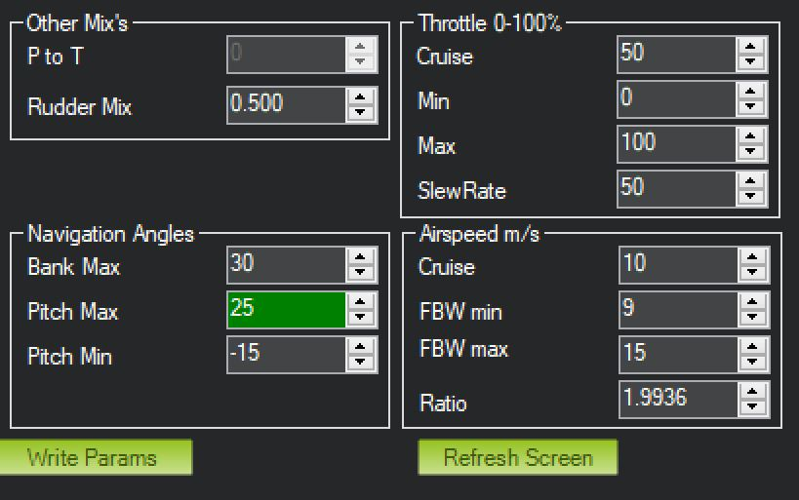
(under Config/Tuning -> Basic tuning)
Appropriate pitch max angle = 25 deg

Slide 12
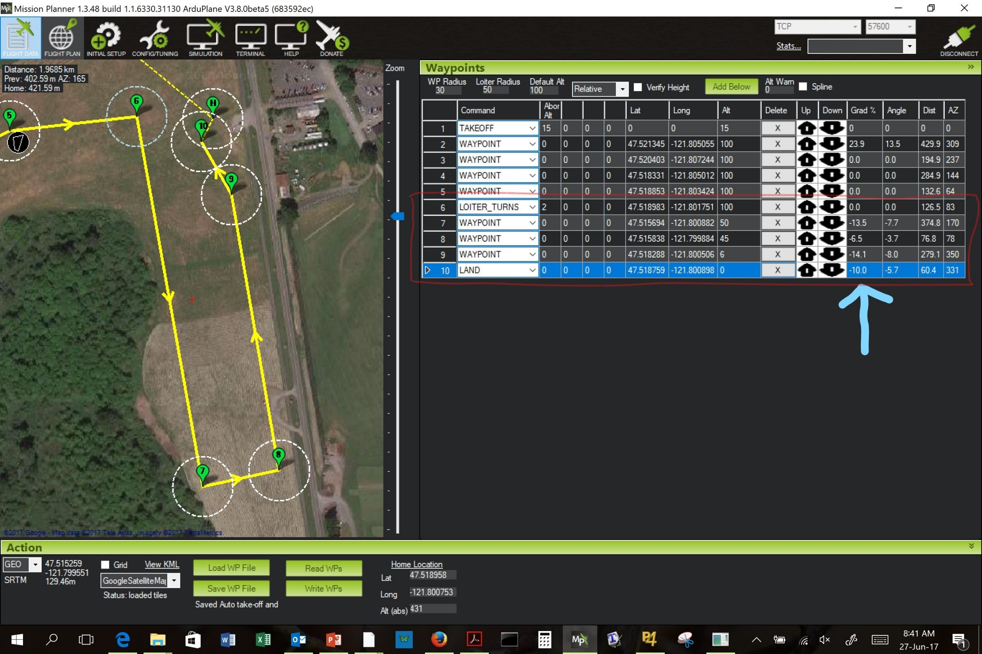

Slide 13
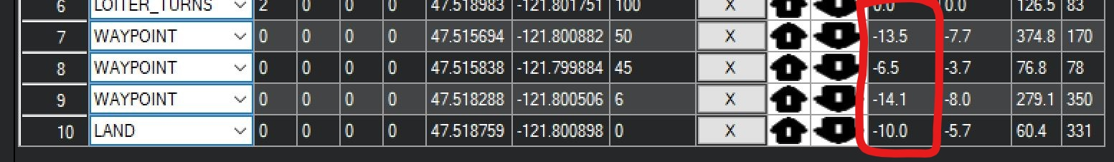
TAKE-OFF GRADIENT < 25%
APPROACH GRADIENT > -15% (< abs(-15%))
FINAL APPROACH GRADIENT > -10% (< abs(-10%))

Slide 14
Anakin auto land on K-drive
..\Missions\17_06_03_Carnation\RawData\AnakinData\Flight056\PicturesAndMedia
..\Missions\17_05_25_meadowbrook\RawData\AnakinData\Flight053\PicturesAndMedia

Slide 15
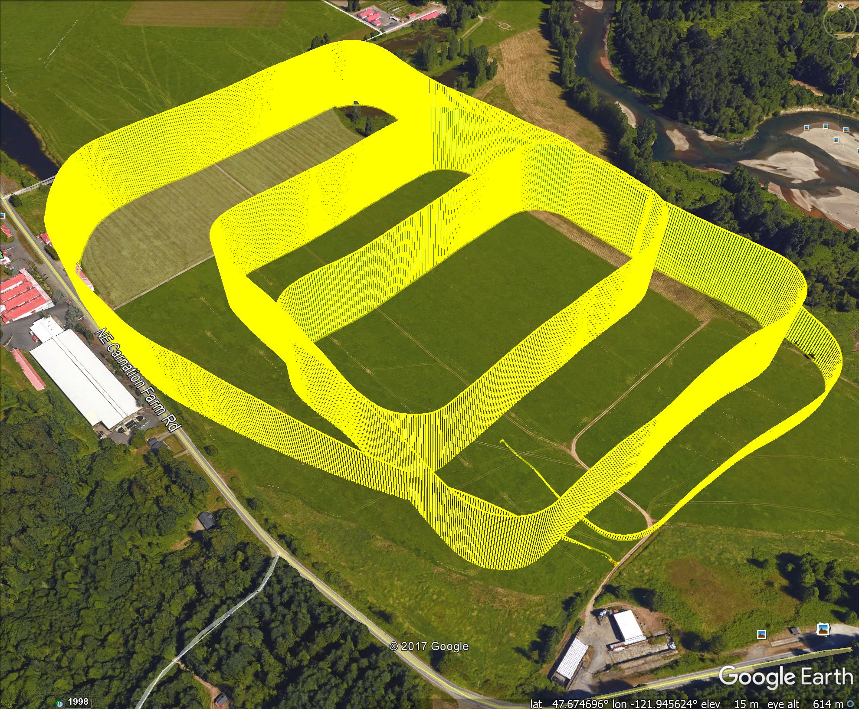

Slide 16
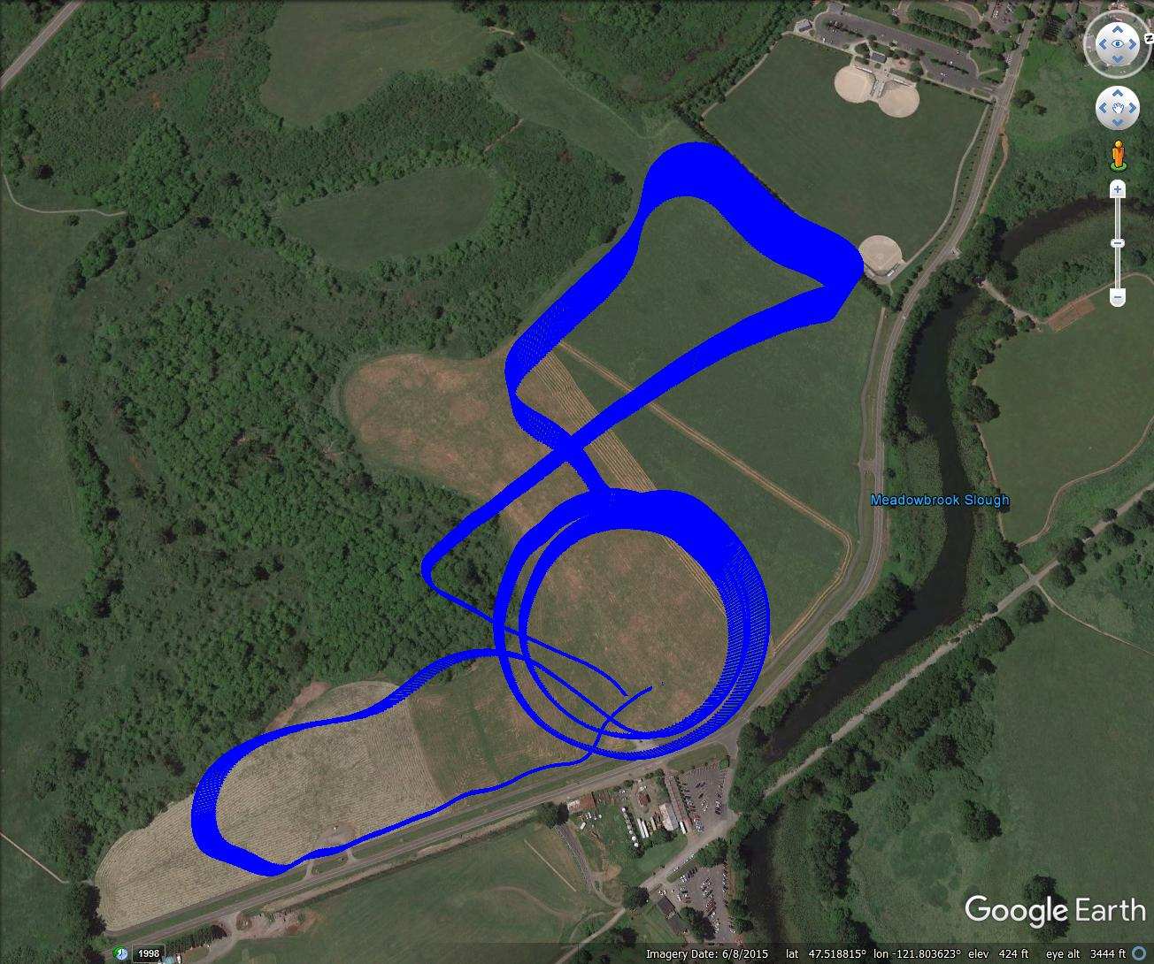

Slide 17
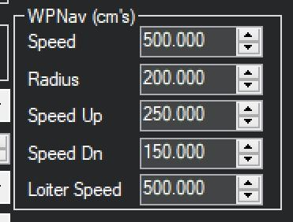
Planning of auto flight take-off and landing for Copter
(under Config/Tuning -> Extended tuning)
AUTO TAKE OFF
- TAKE-OFF
- MISSION
- RTL

Slide 18
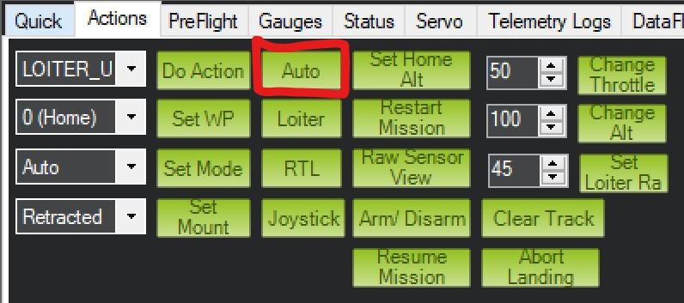
How to activate auto flight?
Prepare mission (under Flight plan)
Check vehicle parameters (under Config / Tuning)
Upload the mission on the Pixhawk (under Flight plan)
Arm motor (under Flight Data / Actions press ARM)
Make servo and motor test
Press AUTO button (under Flight Data / Actions)
Vehicle will start to take off

